Slide 1
Graph Traversal
Traversing a graph means visiting all the
vertices in the graph exactly once.
Breadth First Search (BFS)
Depth First Search (DFS)

Slide 2
DFS
Similar to in-order traversal of a binary search tree
Starting from a given node, this traversal visits all the nodes up to the deepest level and so on.

Slide 3
v₁
v₁
v₈
v₈
DFS
v₂
v₃
v₂
v₃
v₄
v₄
v₅
v₆
v
v₆
5
v₇
v₇
- V₂ - V₅ - V₇ – V₄ - V₈ – V₆ – V₃
DFS : V₁

Slide 4
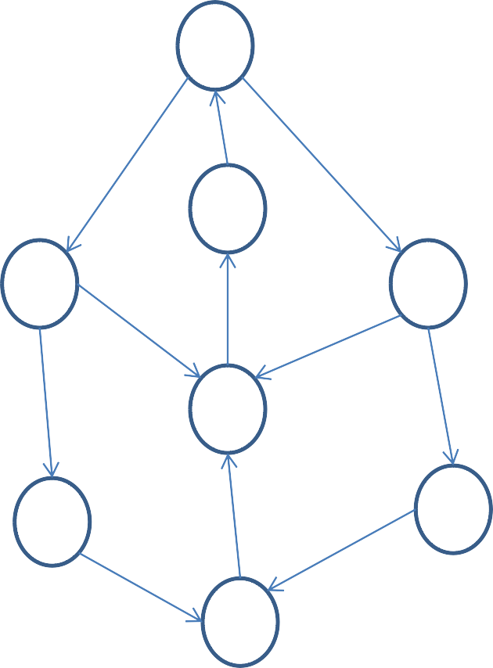
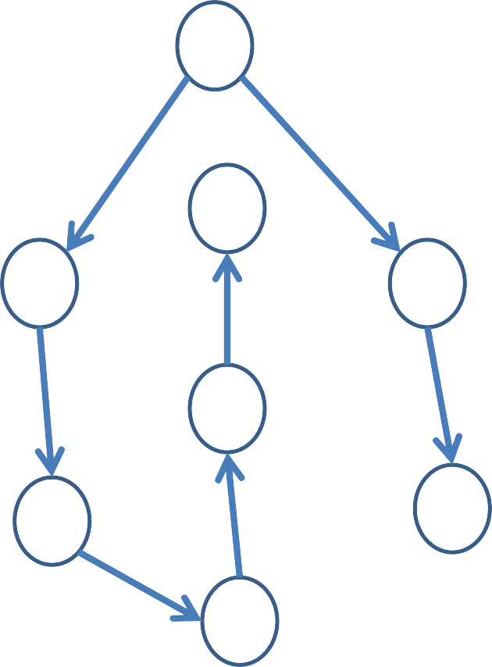
v₁
v
1
v₈
v
v₂
v₃
DFS
8
v₂
v₃
v₄
v
4
v₅
v₆
v₅
v
6
v₇
v
7
DFS : V₁
- V₂ - V₅ - V₇ – V₄ - V₈ – V₃ – V₆

Slide 5
DFS Traversal
Visit the vertex v
Visit all the vertices along the path which begins at v
Visit the vertex v, then the vertex immediate adjacent to v, let it be v_{x} . If v_{x} has an immediate adjacent v_{y} then visit it and so on till there is a dead end.
Dead end: A vertex which does not have an immediate adjacent or its immediate adjacent has been visited.

Slide 6
After coming to an dead end we backtrack to v to see if it has an another adjacent vertex other than v_{x} and then continue the same from it else from the adjacent of the adjacent (which is not visited earlier) and so on.

Slide 7
Push the starting vertex into the STACK
While STACK not empty do POP a vertex V
If V is not visited
Visit the vertex V
Store V in VISIT
PUSH all adjacent vertex of V
onto STACK
End of IF End of While STOP

Slide 8
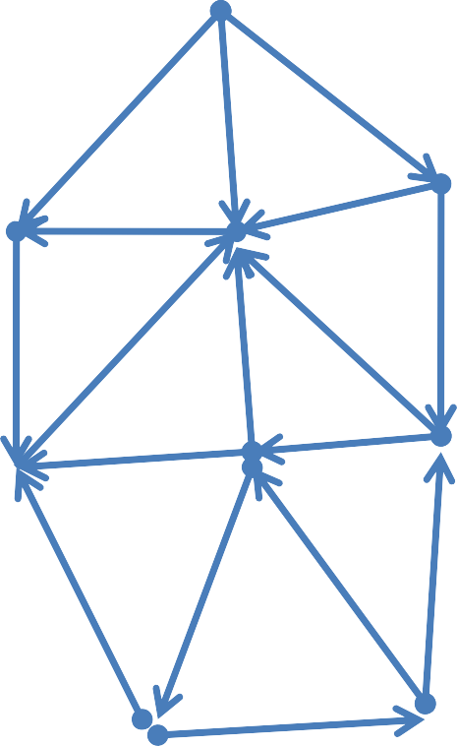
A
Adjacency List
F
C
B
A: F,C,B B: G,C C: F
D: C
E: D,C,J
F: D G: C,E
J: D,K
K: E,G
E
G
D
K
J

Slide 9
DFS of G starting at J
[1] Initially push J onto STACK
STACK : J
VISIT: Ø
[2] POP J from the STACK, add it in VISIT and PUSH onto the STACK all neighbor of J
STACK: D, K VISIT: J

Slide 10
[3] POP the top element K, add it in VISIT and PUSH all neighbor of K onto STACK
STACK: D,E,G
VISIT: J, K
[4] POP the top element G, add it in VISIT and PUSH all neighbor of G onto STACK
STACK: D,E, E, C,
VISIT: J, K, G

Slide 11
[5] POP the top element C, add it in VISIT and PUSH all neighbor of C onto STACK
STACK: D,E,E, F
VISIT: J, K, G, C
[6] POP the top element F, add it in VISIT and PUSH all neighbor of F onto STACK
STACK: D,E, E, D
VISIT: J, K, G, C, F

Slide 12
[5] POP the top element D, add it in VISIT and PUSH all neighbor of D onto STACK
STACK: D,E,E, C
VISIT: J, K, G, C, F,D
[6] POP the top element C, which is
already in VISIT
STACK: D,E, E VISIT: J, K, G, C, F,D

Slide 13
[5] POP the top element E, add it in VISIT which is already in VISIT and its neighbor onto STACK
STACK: D,E, D, C, J
VISIT: J, K, G, C, F,D,E
[6] POP the top element J, C, D,E, D which is already in VISIT
STACK:
VISIT: J, K, G, C, F, D, E

Slide 14
A
Adjacency List
F
C
B
A: F,C,B B: G,C C: F
D: C
E: D,C,J
F: D G: C,E
J: D,K
K: E,G
E
G
D
K
J
J, K, G, C, F, D, E

Slide 15
BFS Traversal
Any vertex in label i will be visited only after the visiting of all the vertices in its preceding level that is at level i – 1

Slide 16
BFS Traversal
[1] Enter the starting vertex v in a queue Q
[2] While Q is not empty do
Delete an item from Q, say u
If u is not in VISIT store u in
VISIT
Enter all adjacent vertices of u
into Q
[3] Stop

Slide 17
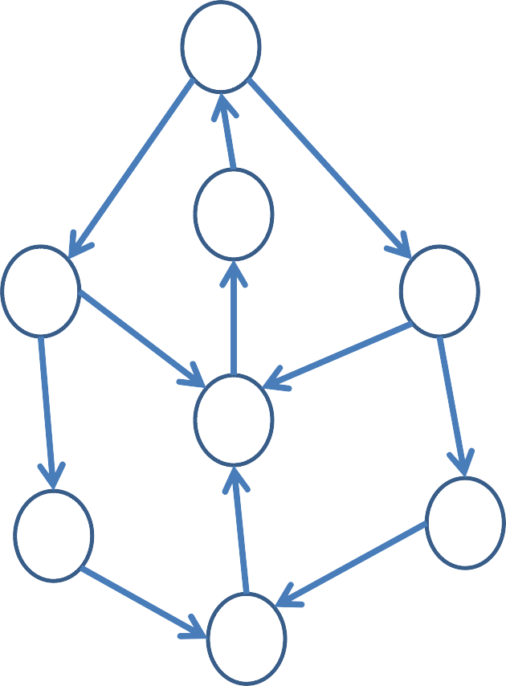
v₁
v₈
v₂
v₃
v₄
v₅
v₆
v₇

Slide 18
[1] Insert the starting vertex V₁ in Q
Q = V₁ VISIT = Ø
[2] Delete an item from Q, let it be u = V₁ u is not in VISIT. Store u in VISIT
and its adjacent element in Q
Q = V₂ , V₃ VISIT = V₁

Slide 19
[3] Delete an item from Q, let it be u = V₂
u is not in VISIT. Store u in VISIT and its adjacent element in Q
Q = V₂ , V₃ , V₄ , V₅
VISIT = V₁ , V₂
[4] Delete an item from Q, let it be u = V₃
u is not in VISIT. Store u in VISIT
and its adjacent element in Q
Q = V₃ , V₄ , V₅ , V₄ , V₆
VISIT = V₁ , V₂ , V₃

Slide 20
[5] Delete an item from Q, let it be u = V₄
u is not in VISIT. Store u in VISIT and its adjacent element in Q
Q = V₄ , V₅ , V₄ , V₆ , V₈
VISIT = V₁, V₂, V₃ , V₄
[6] Delete an item from Q, let it be u =V₅
u is not in VISIT. Store u in VISIT
and its adjacent element in Q
Q = V₅ , V₄ , V₆ , V₈ , V₇ VISIT = V₁ , V₂ , V₃ , V₄ , V₅

Slide 21
[7] Delete an item from Q, let it be u =V₄
u is in VISIT.
Q = V₄ , V₆ , V₈ , V₇
VISIT = V₁ , V₂ , V₃ , V₄ , V₅
[8] Delete an item from Q, let it be u =V₆ u is not in VISIT. Store u in VISIT
and its adjacent element in Q
Q = V₆ , V₈
VISIT = V₁
, V₇
, V₂ , V₃ , V₄ , V₅ , V₆

Slide 22
[9] Delete an item from Q, let it be u =V₈
u is not in VISIT. Store u in VISIT and its adjacent element in Q
Q = V₈ , V₇ , V₁
VISIT = V₁ , V₂ , V₃ , V₄ , V₅ , V₆ ,
V₈
[10] Delete an item from Q, let it be u =V₇
u is not in VISIT. Store u in VISIT and
its adjacent element in Q
Q = V₇ , V₁
VISIT = V₁ , V₂ , V₃ , V₄ , V₅ , V₆ ,
V₈ , V₇

Slide 23
[11] Delete an item from Q, let it be u =V₁
u is in VISIT. Q = V₁
VISIT = V₁ , V₂ , V₃ , V₄ , V₅ , V₆ ,
V₈ , V₇
[12] Q is empty, Stop
Q =
VISIT = V₁ , V₂
, V₃ , V₄ , V₅ , V₆ ,
V₈ , V₇

Slide 24

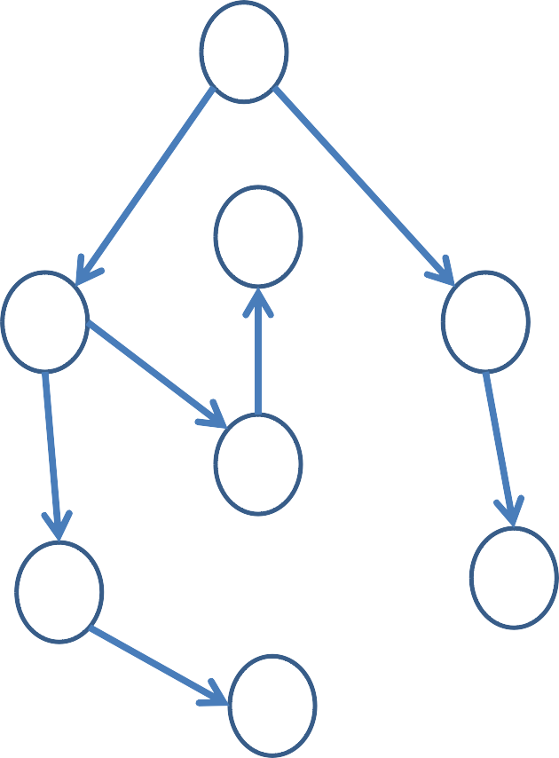
v₁
v₁
v₈
v₈
v₂
v₃
BFS
v₂
v₃
v₄
v₄
v₅
v₆
v
v₆
5
v₇
v₇

